Slide 1


FOOD ADVERSE EVENTS IDS SEM 3 PROJECT
NAME | SRN
NIKHIL JK | PES2201800303
V MAHENDRA VARMA | PES2201800661
NIKHIL KHARLE | PES2201800642

Slide 2
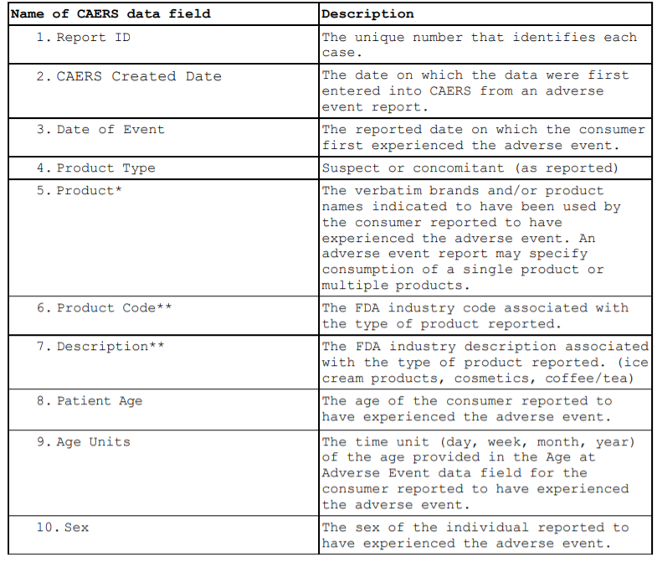

Slide 3
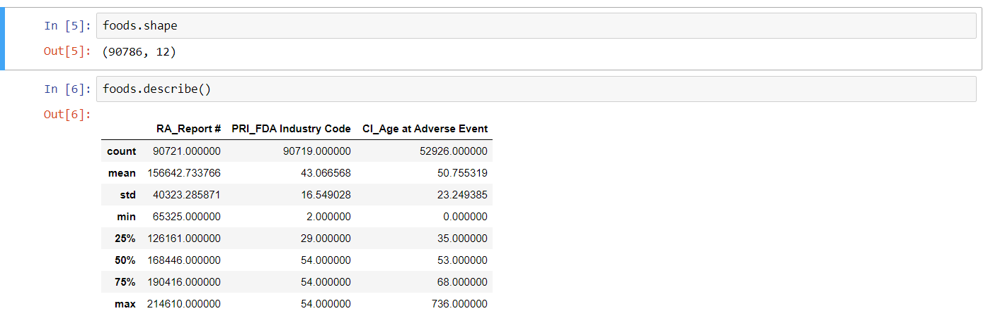
1. Description of Dataset
1.Total number of columns - a) Numerical columns=03 b) Categorical columns – 9 2.Total number of rows – 90786 3.Data as missing values and NAN – 6.9 % (75280 values)

Slide 4
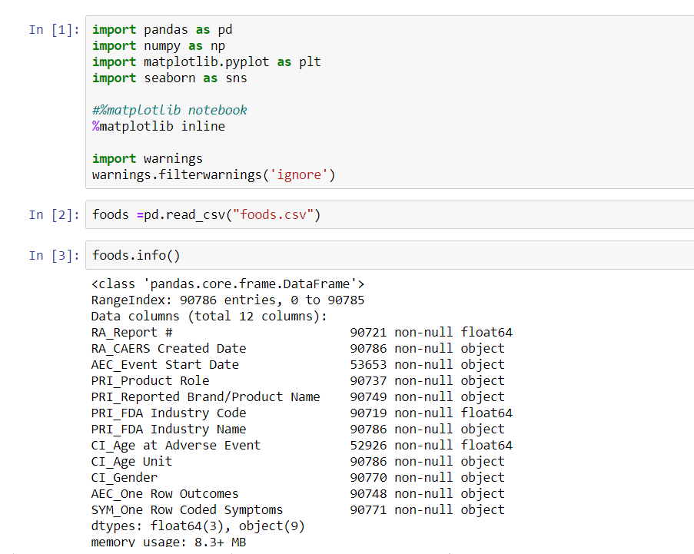
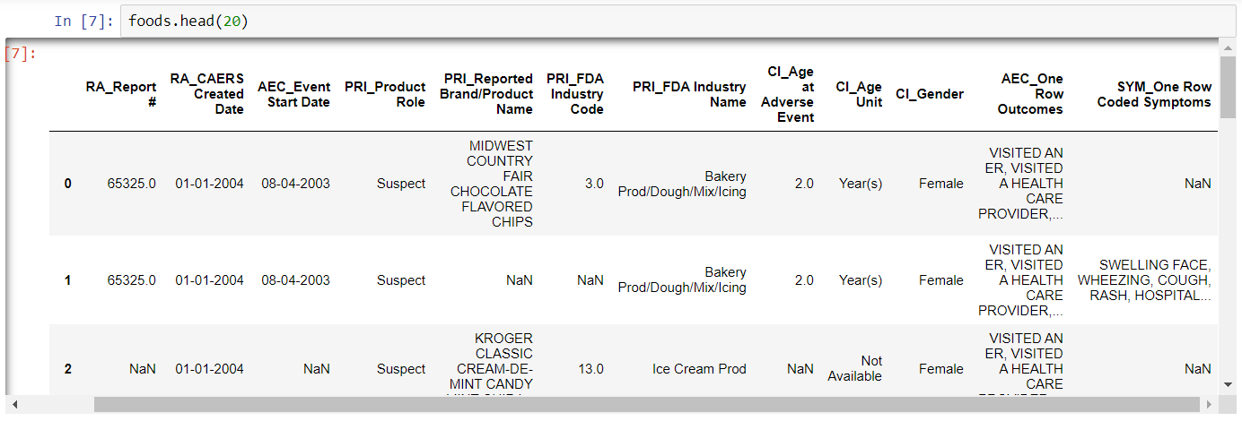
2. Data Cleaning

Slide 5
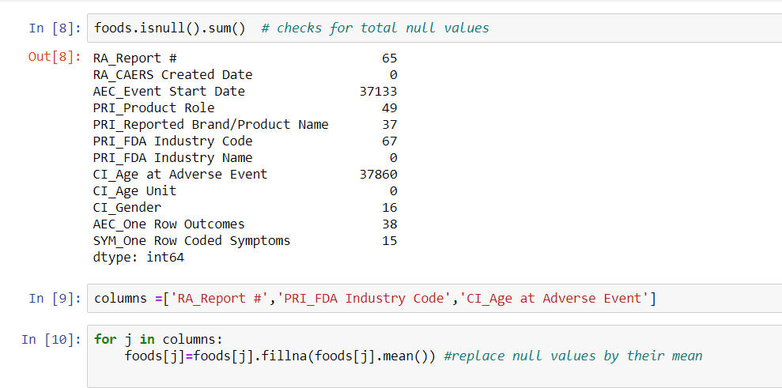
2. Data Cleaning 1. To check total number of missing values or NAN and 2.To clean numerical columns all NAN values for numerical columns are replaced with mean of the particular column

Slide 6
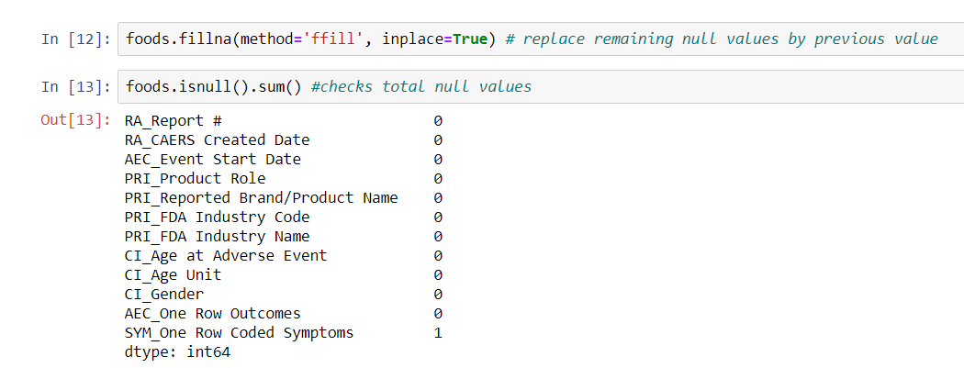
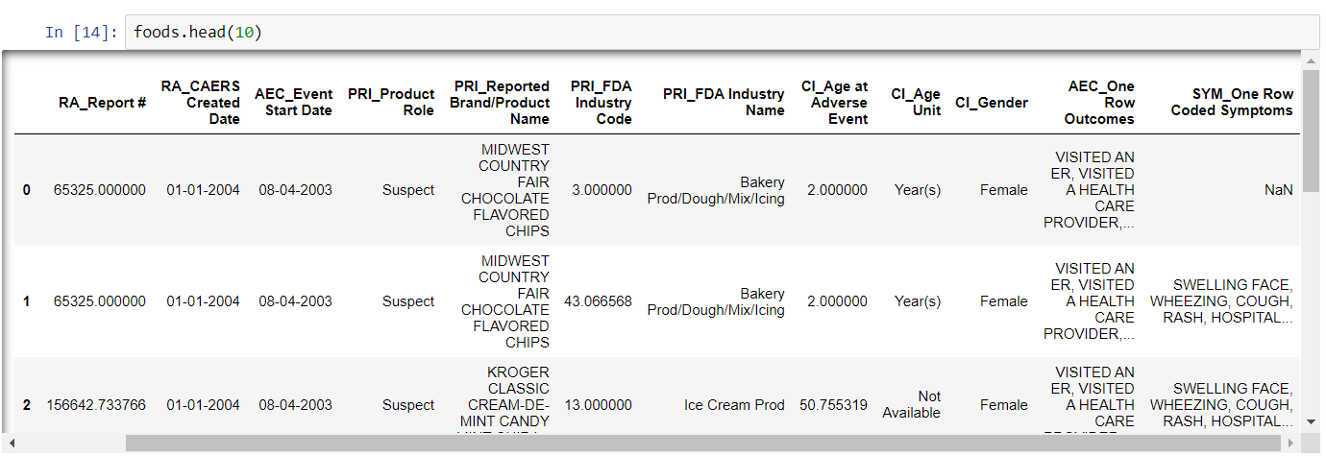
3. To clean categorical columns and clean all remaining NAN values all NAN values are replaced with its previous row values

Slide 7
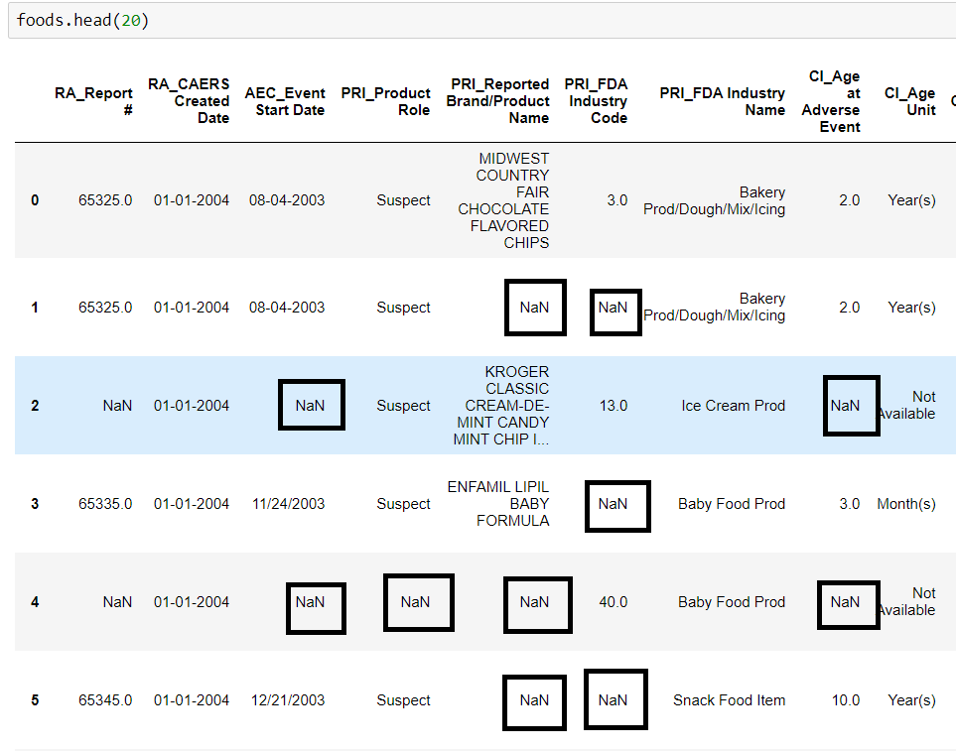
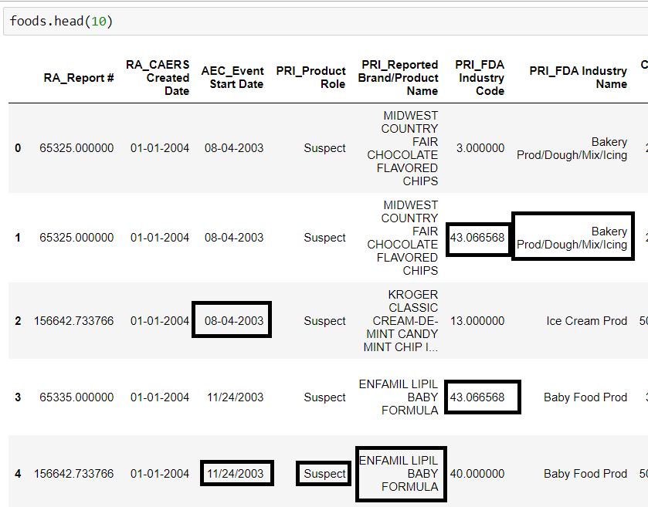
Before Data Cleaning
After Data Cleaning

Slide 8

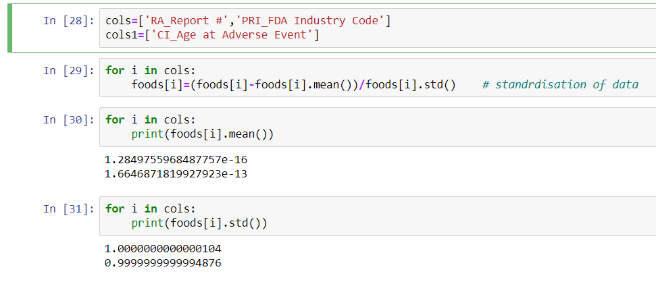
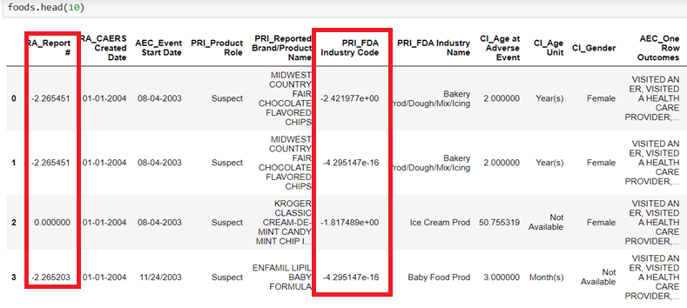
3. STANDARDISATION -rescaling the distribution of values so mean of observed values to 0 and standard deviation is 1 done for column RA-Report -Industrycode

Slide 9
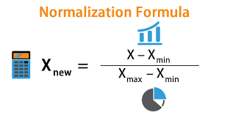
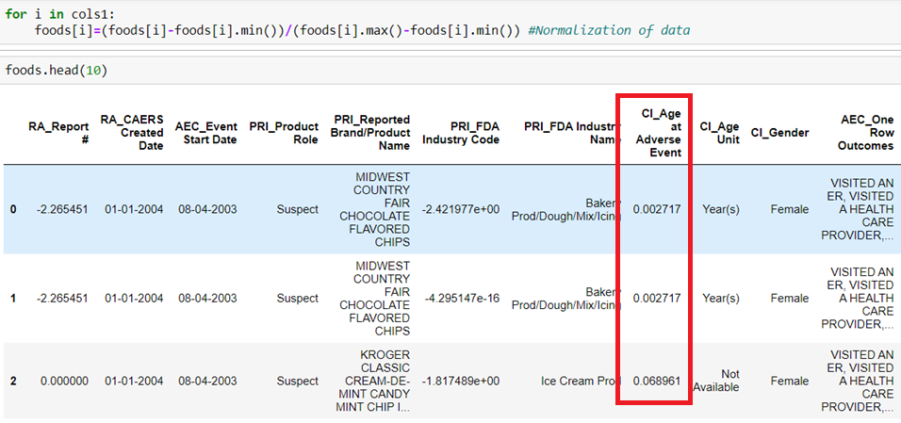
4.NORMALIZATION --typically rescales the values into a range of [0,1]. -- to change the values of numeric columns in dataset to a common scale, without disorting in range values. Done for column CI-Age-At –Adevrse-event

Slide 10
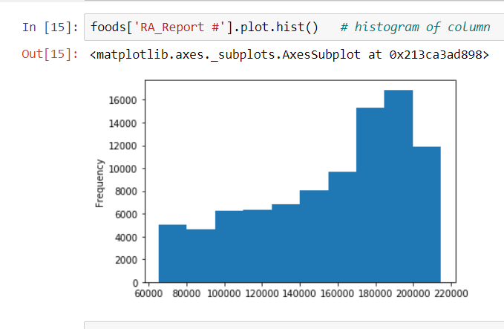
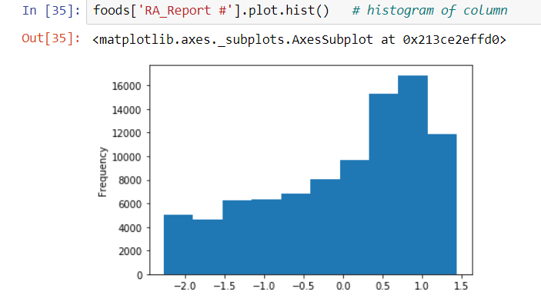
NORMALIZATION The database normalization is nothing but organizing tables and columns of table in such a way that to reduce redundancy and complexity of data and to improve data integrity. WHY DATA NORMALIZATION IS IMPORTANT ? * To eliminate useless data *To ensure data dependencies and data is logically stored .

Slide 11
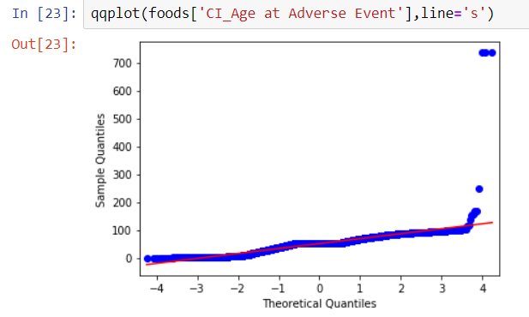
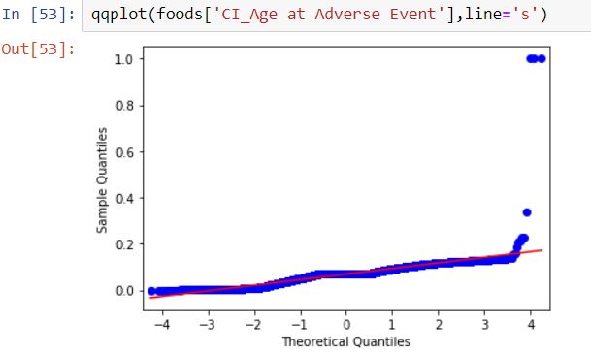
Data is Normal for CI Age at Adverse Event column due to all points lying in same line

Slide 12
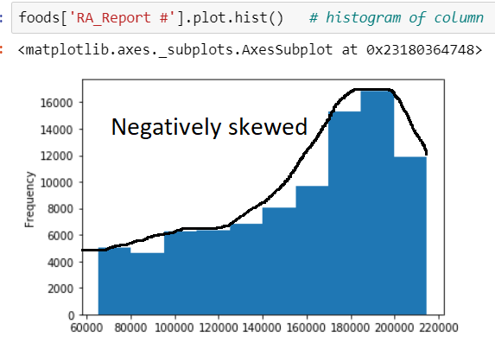
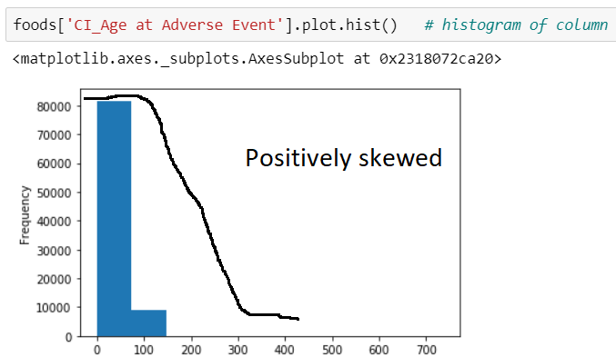
4. Graphs visualization of data 1.Histogram
Histogram is used to summarize discrete or continuous data.
Positive skewed
CI_Age-Adverse _event(most data falls to right) where
Mode < median <mean
Here the graph of the column RA_Report shows negative skewed (most data falls to left) where
Mode>median>mean

Slide 13
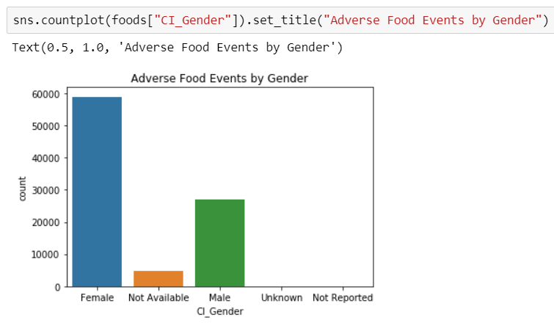
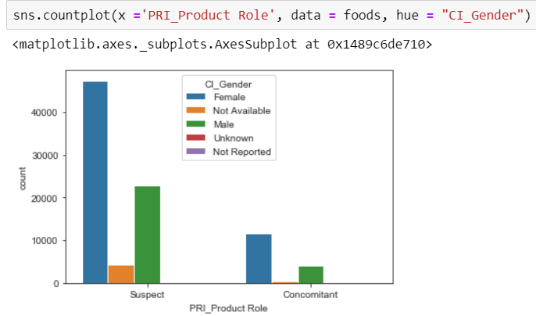
2. Bar graph
The bar graph 01 is a chart that presents categorical data with rectangular bars and shows comparison among discrete categories .
The bar graph of the data here represents column gender .it contains :
The number of females are nearly 60k
The number of males are around 30k
Not available around 10k
Graph 01
Graph 02
The graph 02 about the column
Pri_Product rule vs Gender . It describes about
No of females ,males ,unknown, who are suspect and concomitant
And yellow bar represents the people whose identity couldn’t be recognized

Slide 14
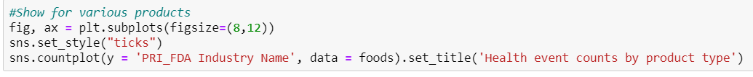
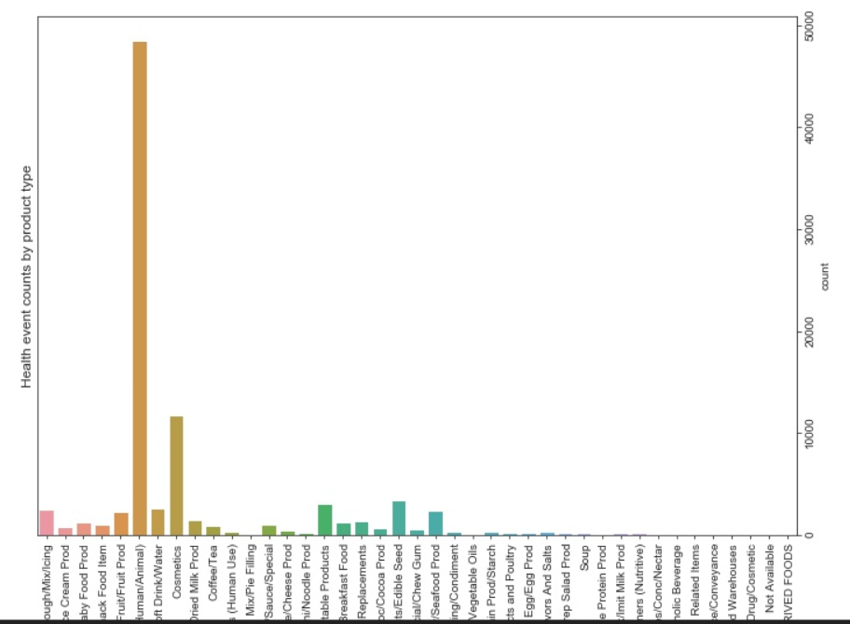
Bar graph visualization on food product industry name vs health counts
This graph tells about the column PRI_FDA_Industrury name vs health events counts by product type as here
Animal food has more counts on health
And drug alcoholic has least count on health similarly or all baby foods dried ,milkfood etc

Slide 15
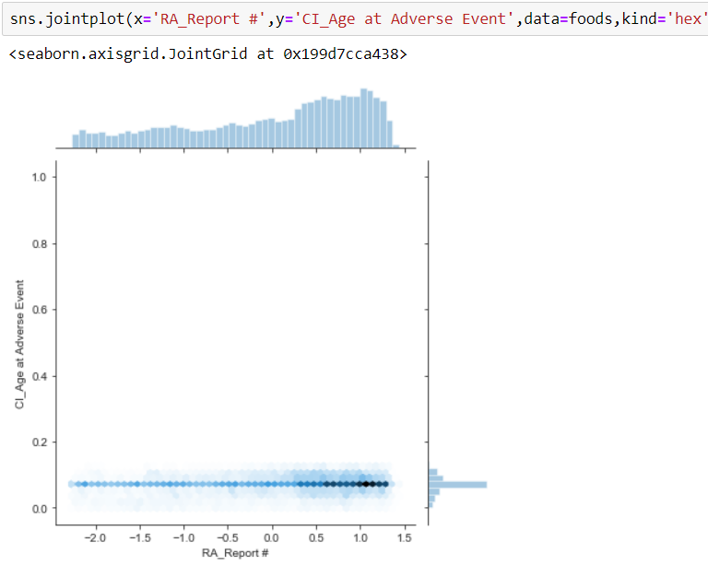
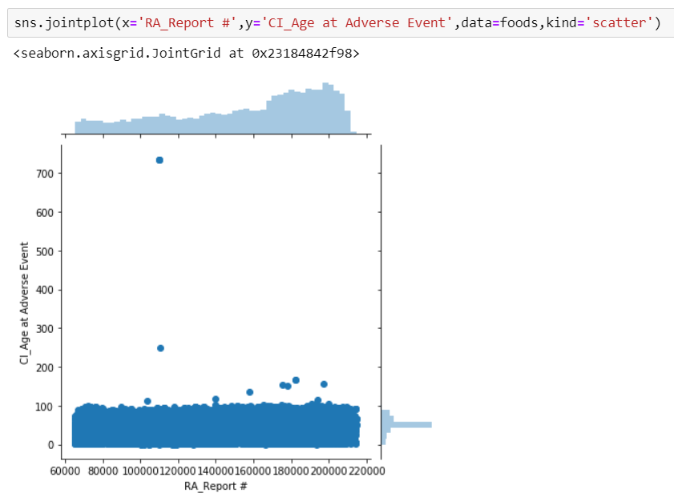
3 . Scatter plots 4.hex plots .
It is a mathematical representation. Dots are used to represent values of variables.
Graph for 2 columns RA Report and CI Age at Adverse Event . Data is more scattered below
Used to check for linear regression.
It shows exactly where data is more populated

Slide 16
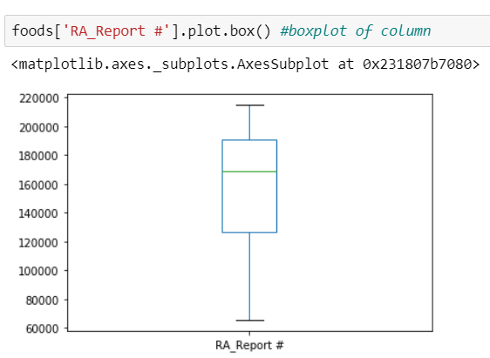
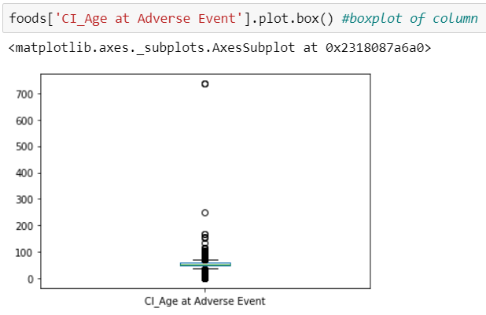
5 . Box plot Is a method for graphically depicting groups of data through quartiles It shows about outliers ,1st ,2nd and 3rd quartile ,maximum and minimum value ,upper&lower stream. It tells about normal data if outliers are present then the data is not normal ,orelse the data is said to be normal. here the data RA_Report does not contain any outliers ,so the data is normal. the data ci age at adverse event contains outliers ,so the data is not normal.

Slide 17
5. Hypothesis testing
Hypothesis testing is a statistical procedure that uses sample data to determine, whether a statement about the value of a population parameter should or should not be rejected.
Here we do hypothesis testing for the column PRI_FDA Industry Code .
Our population mean was 43.066 so we assume that the sample mean is same as population mean.
Thus our Null Hypothesis will be that
H0 : mu = 43.0665
H1 : mu != 43.0665

Slide 18
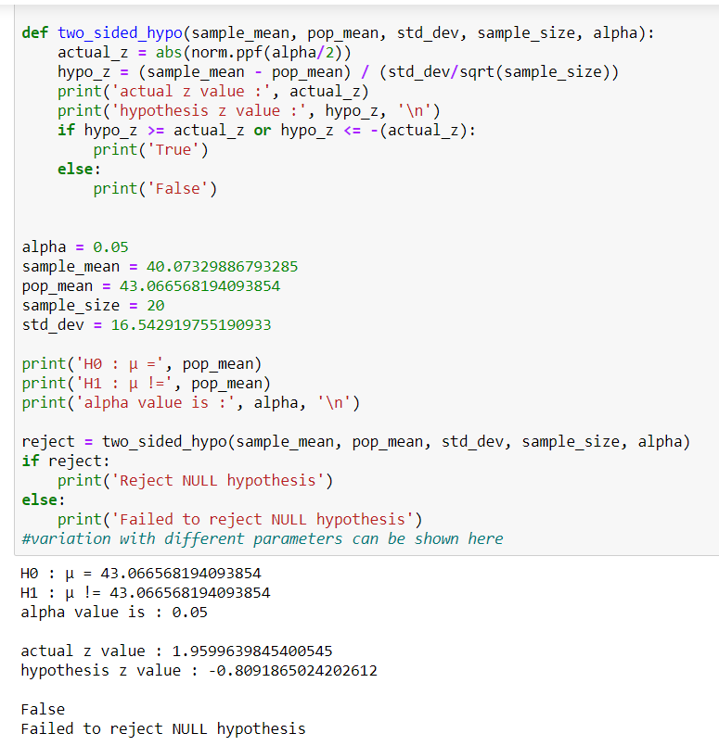
Steps involved in Hypothesis Testing
Here Z value is -0.8091
Since it is two tailed test so p value becomes
→0.2119+0.2119=0.4238
As p value (alpha )=0.05
P-value is greater than (alpha)value (significance level)
So we fail to reject null hypothesis (H0)
Due to strong evidence on H0 we fail to reject H0

Slide 19
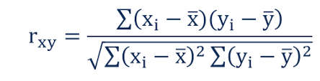
6.Correlation It measures the strength and direction of a linear relationship between two variables on a scatterplot the value always lie between -1 to 1
To find coefficients (r) value
if R value is 0 then there is no linear relationship between two columns
If r value is negative then there is weak linear relationship
If R value is positive then there is strong linear relationship.

Slide 20
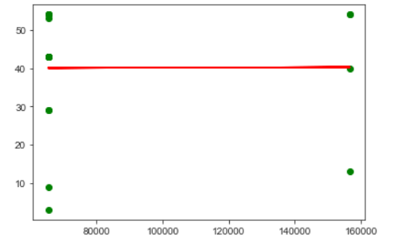
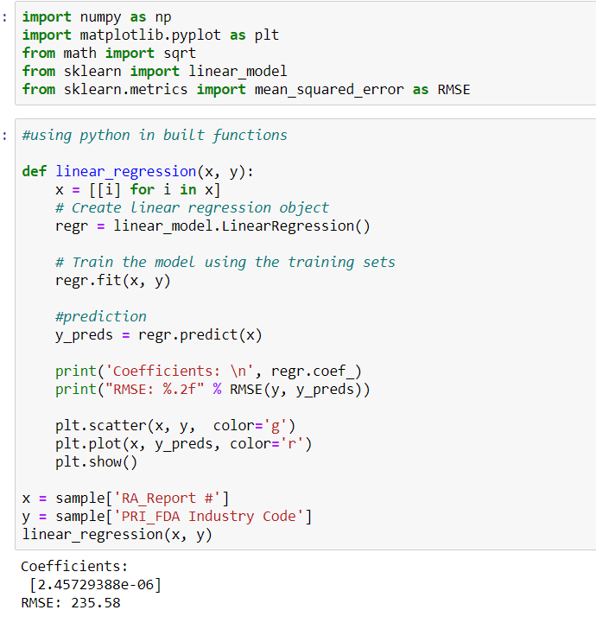
CORRELATION BETWEEN RA_Report and PRI_FDA Industry Code
Coefficient r value =2.457*e^-6 ~ 0.006 so we can conclude that there is non relationship btw the columns RA_Report and PRI_FDA industry code.

Slide 21
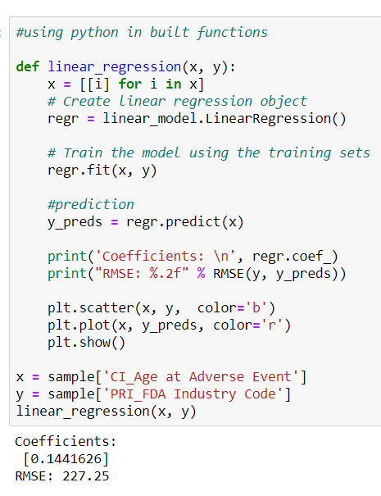
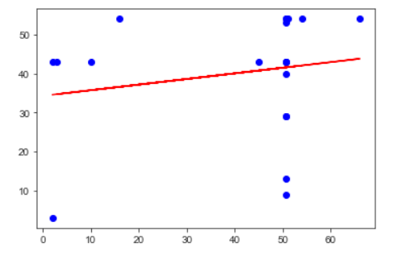
Correlation ship between CI_Age at Adverse Event and PRI_FDA Industry code
The relation b/w CI_Age at Adverse Event and PRI_FDA Industry code coefficient(r) is 0.1441626 so it has a weak uphill positive linear relation ship .

Slide 22
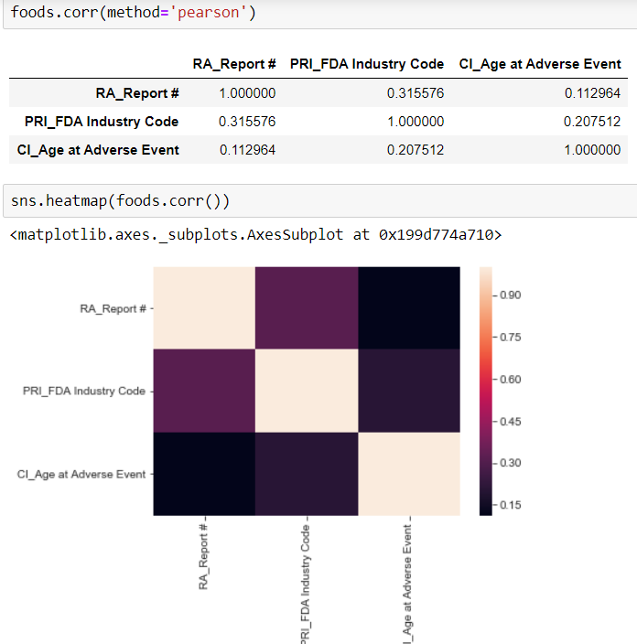
Pearson’s correlation

Slide 23
THANK YOU

